Slide 1
Inventory Management System (IMS)
QA FUNDAMENTAL PROJECT
22MayEnable2

Slide 2
INTRODUCTION
Hello, my name is Erhan Aksu. This is my Week 5 fundamental project.
The project requirements are building a customers, items, and orders ims system that is fully CRUD functional.
Application has to run on cli.

Slide 3
Scope
The requirements of the project are as follows:
Code fully integrated into a Version Control System using the feature-branch model: main/dev/multiple features.
A project management board with full expansion on user stories, acceptance criteria and tasks needed to complete the project.
A risk assessment which outlines the issues and risks faced during the project timeframe.
A relational database used to persist data for the project, containing the customers, items, orders, and orders_items tables. Relationships should be modelled using an ERD.
A functional application ‘back-end’, following best practices and design principles, in the language that you have covered during training, meeting the requirements set on your project management board.
A build of your application, including any dependencies it might need, produced using an integrated build tool.
Unit tests for validation of the application. You should aim to reach the industry standard of 80% test coverage.

Slide 4
Applications and software used to build this IMS application:
Version Control System : Git
Source Code Management : GitHub
Scrum Board : Jira
Database Management System : MySql Server
Back-End Programming Language : Java
Build Tool : Maven
Unit Testing : Junit & Mockito

Slide 5
Ci Version Control
GitHub Was Used With Multiple Feature Branches and tracked the project with smart commits on Kanban Board.

Slide 6
tESTING
STILL IN PROGRESS…..

Slide 7
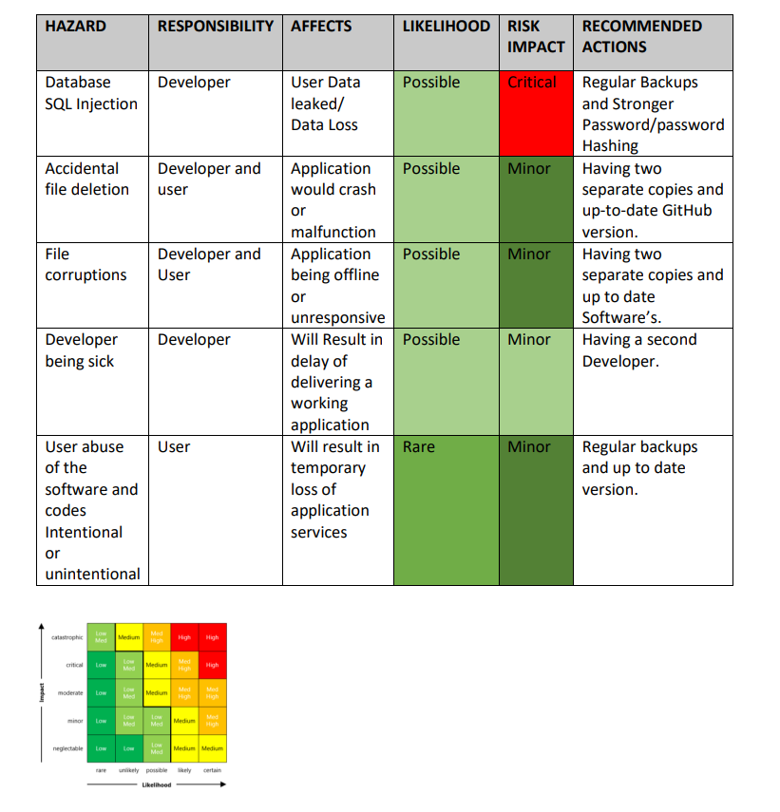
Risk Assessment

Slide 8
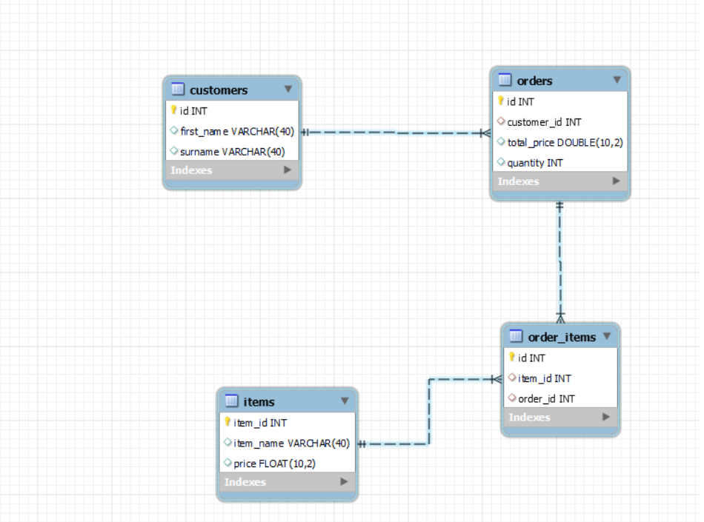
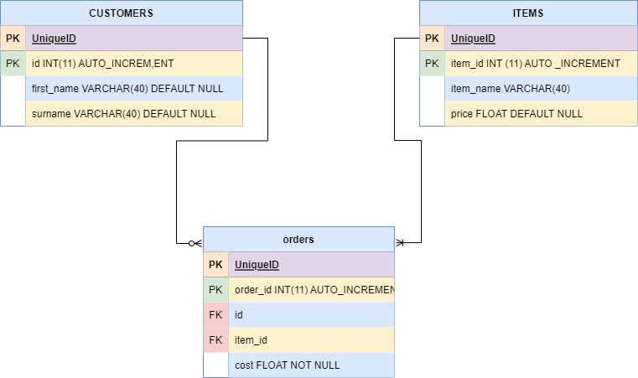
Database erd

Slide 9
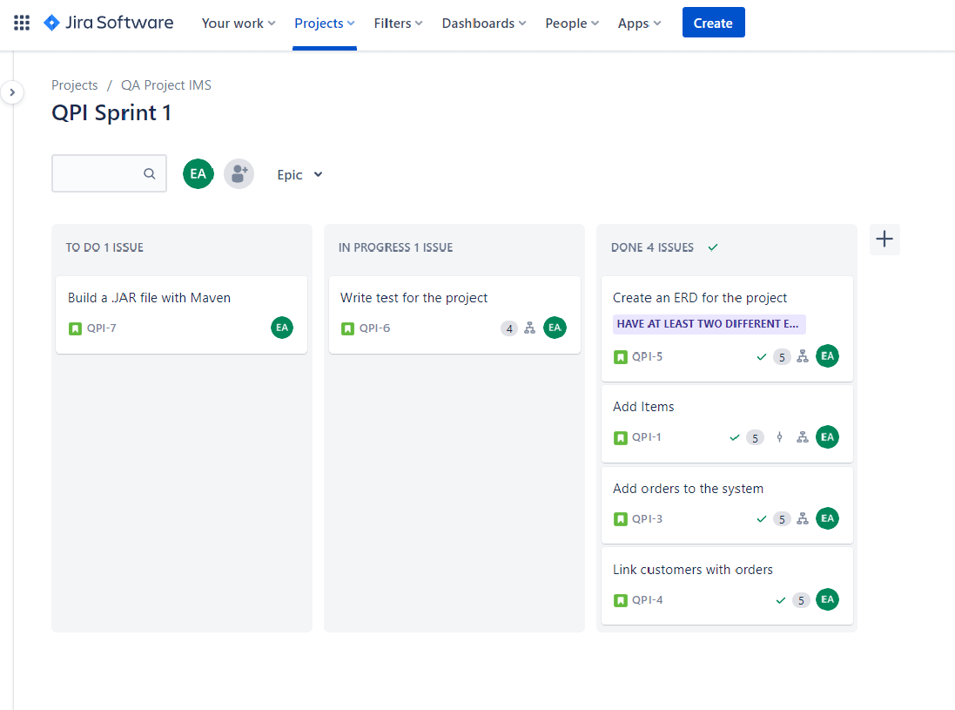
Project management jira

Slide 10
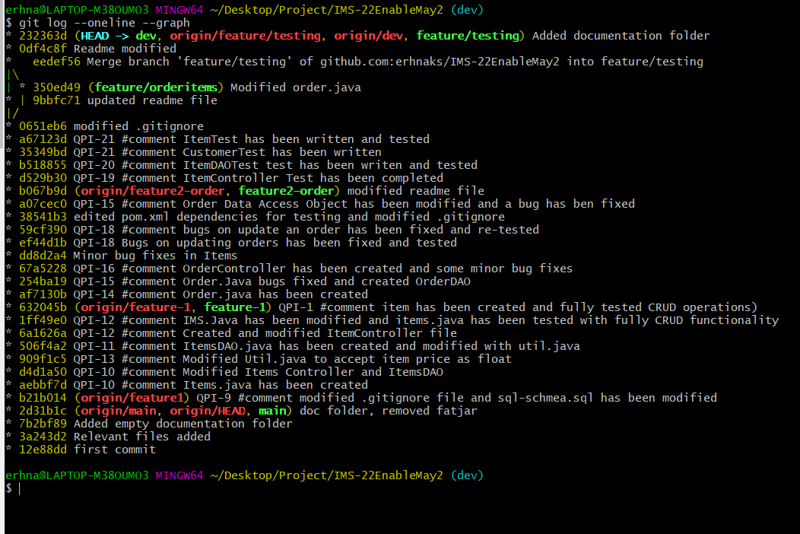
Github and branches

Slide 11
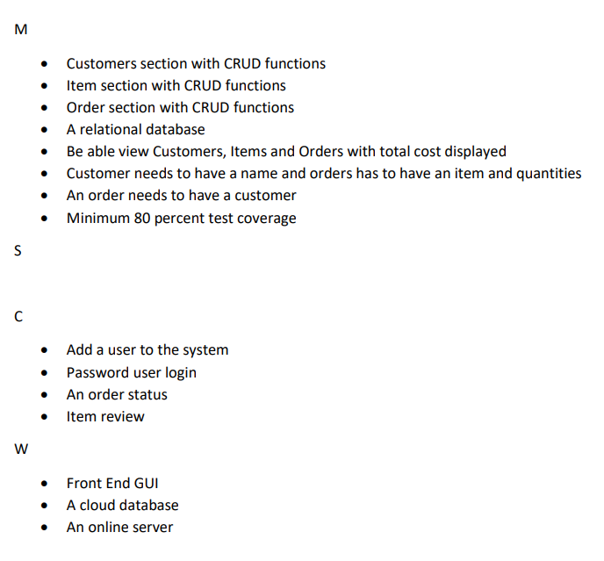
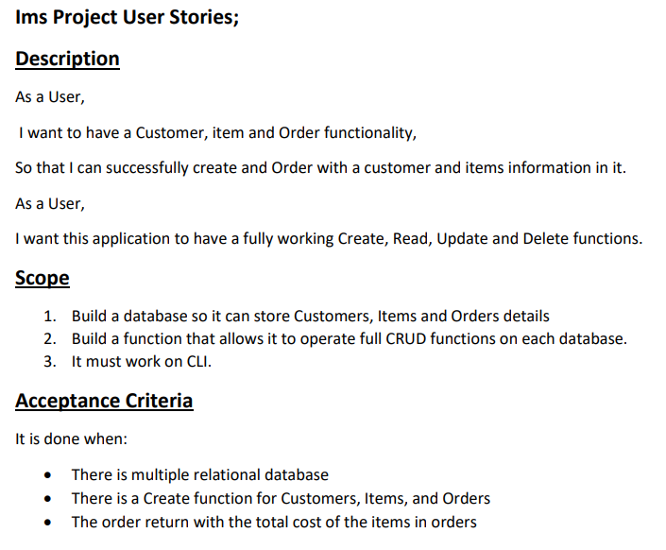
MOScow and user story

